Slide 1
Inventra – Intelligent Inventory Management System
NITISH KUMAR CHAUDHARY

Slide 2
INTRODUCTION
Inventra is an enterprise-level Intelligent Inventory Management System designed to automate inventory tracking, monitor stock levels in real time, and generate alerts when inventory falls below predefined thresholds. The system helps organizations reduce manual errors, avoid stock-outs, and improve operational efficiency through data-driven insights.

Slide 3
PROBLEM STATEMENT
Traditional inventory management systems face several challenges:-
Manual tracking leads to errors and inconsistencies
Lack of real-time stock monitoring
No automated alert mechanism for low stock
Time-consuming report generation
Inefficient decision-making due to limited analytics

Slide 4
Solution Overview
Inventor addresses these challenges by:-
Automating inventory tracking
Providing real-time stock monitoring
Generating low-stock alerts automatically
Offering detailed reports and analytics
Ensuring secure access using authentication
Reducing human errors and improving efficiency

Slide 5
System Architecture
Front-End: HTML, CSS, JavaScript
Back-End: Java (JDK 8/11)
Frameworks: spring Boot
Database: MySQL
Tools: VS Code
User → Frontend → Backend → Database → Alerts / Reports

Slide 6
USER
(Admin / Staff)
FRONT-END
HTML, CSS, JS
(User Interface)
BACK-END
Java (JDBC)
Authentication
Inventory Logic
Alerts
DATABASE
MySQL
Users
Products
Stock Details

Slide 7
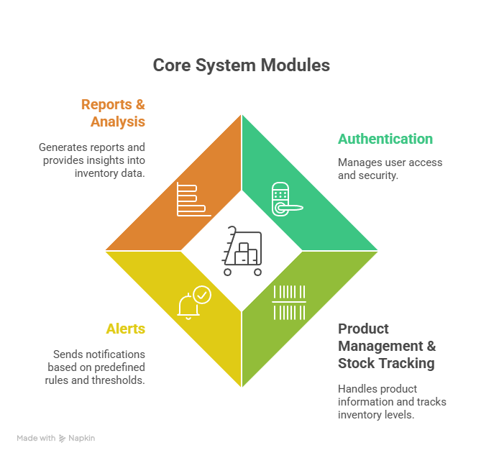
System Modules
The Intelligent Inventory Management System consists of four key modules:
Authentication: Manages user access and security.
Product Management & Stock Tracking: Handles product information and tracks inventory levels.
Alerts: Sends notifications based on predefined rules and thresholds.
Reports & Analysis: Generates reports and provides insights into inventory data.

Slide 8
Module 1 Authentication
Handles secure user login and logout functionality
Validates user credentials against stored data
Ensures authorized access to the system
Prevents unauthorized users from accessing inventory data
Maintains session control for logged-in users
Uses role-based access (Admin/User)

Slide 9
Module 1 Authentication
Input:
Username and password entered by user
Process:
Validates credentials against database
Verifies user role (Admin / Staff)
Creates and manages user session
Output:
Secure login access
Role-based dashboard displayed

Slide 10
Classes
Classes:
AUTH Controller: Handles authentication-related HTTP requests.
AUTH Service: Implements the authentication logic.
AUTH Repository: Interacts with the User Database.
User: Represents a user in the system (database entity).

Slide 11
Work flow
Process:
User enters credentials (username/password).
AUTH Controller receives the request.
AUTH Controller calls AUTH Service to validate the credentials.
AUTH Service calls AUTH Repository to retrieve user data from the User Database.
AUTH Repository queries the User Database.
AUTH Service compares the entered credentials with the data from the database.
AUTH Controller returns the token to the user.

Slide 12
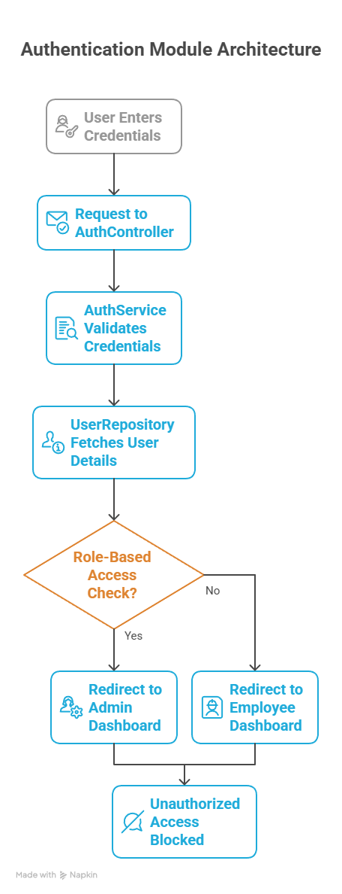
Flow
Signup
UI → Controller → Service → Repository → Database
Sign in
UI → Controller → Service → JWT Token → UI
Forgot Password
UI → Controller → Service → Email Service → User

Slide 13
Authentication Database Schema
Field | Datatype | Description
Userid | Primary Key | Unique User ID
Username | Varchar | Unique Username
Password | Varchar | User Email Address
Email | Varchar | Encrypted Password
Role | Varchar | Authorization/Permissions
Created_at | Datetime | Automatically records

Slide 14
Module 2 Product / Inventory Management
Allows users to add new products with details such as name, category, quantity, and price
Enables updating and deleting existing product records
Maintains real-time stock information
Ensures data consistency across inventory operations
Supports efficient management of product lifecycle

Slide 15
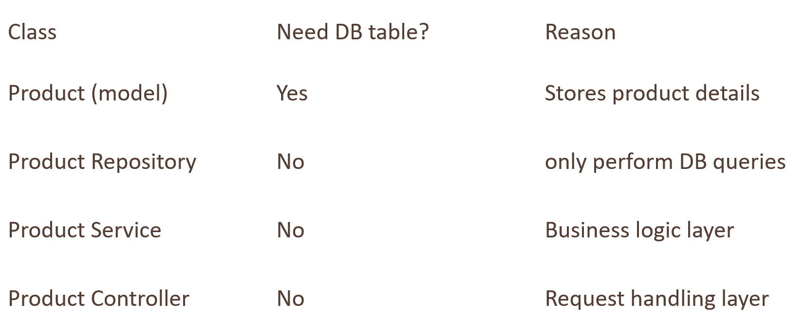
Database

Slide 16
Module 2 Product / Inventory Management
Input:
Product details (name, category, quantity, price)
Update or delete requests
Process:
Stores and updates product data in database
Maintains real-time stock information
Ensures data consistency
Output:
Updated inventory records
Accurate stock availability displayed

Slide 17
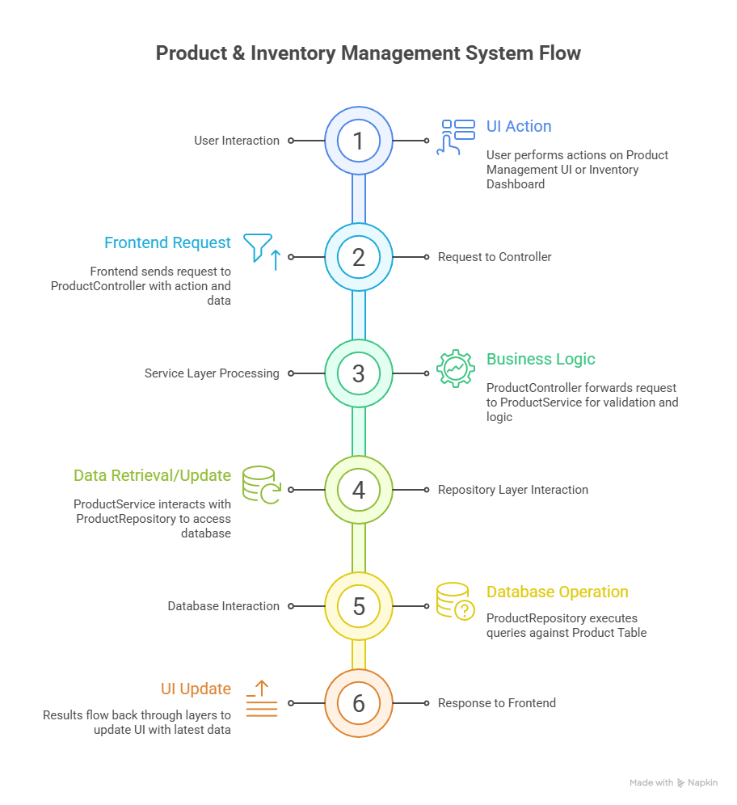
classes
Main Classes in this Module is :
Product class : Represents product details
Product Controller : give request to service
Product Service : business logic
Product Repository : communicate with database

Slide 18
Module 3 Inventory / Alerts
Continuously monitors inventory levels in real time
Compares current stock against predefined threshold values
Automatically triggers alerts when stock reaches critical levels
Notifies users to take timely replenishment actions
Helps minimize stock-out risks and operational delays

Slide 19
Module 3 Inventory / Alerts
Input:
Current stock levels
Predefined threshold values
Process:
Continuously monitors stock quantities
Compares stock with threshold limits
Triggers alert conditions
Output:
Low-stock alerts generated
Notifications for timely replenishment

Slide 20
classes
Product: The fundamental object representing an inventory item, containing the current stock and the threshold that triggers alerts.
Alert: A concrete record created by the system when a threshold is breached, detailing the issue, the product, and the status.
Alert Controller: Handles external user requests (e.g., viewing or closing alerts) and routes them to the service layer.
Alert Service: Executes the core business logic, constantly monitoring products, generating new alerts, and managing alert statuses.
Alert Repository: Manages all data interactions, specifically saving, retrieving, and updating Product and Alert records in the database.

Slide 21
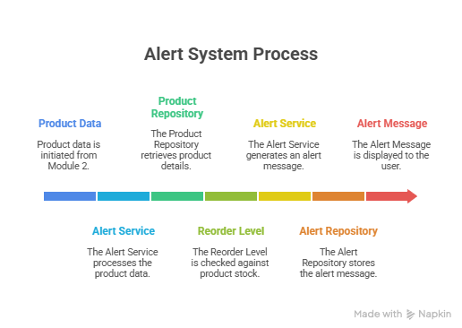
Flow
Alert service----product repository----checks quantity < reorder level
Alert service ----Alert repository-----creates alert
Alert controller----shows alert to Ui

Slide 22
Module 4 Reports & Analytics
Generates detailed inventory reports
Provides insights into stock availability and usage patterns
Supports analysis of inventory trends over time
Helps management in data-driven decision making
Improves planning and inventory optimization

Slide 23
Module 4 Reports & Analytics
Input:
Inventory and transaction data
Process:
Analyzes stock usage and trends
Generates reports and summaries
Output:
Inventory reports
Analytical insights for decision-making

Slide 24
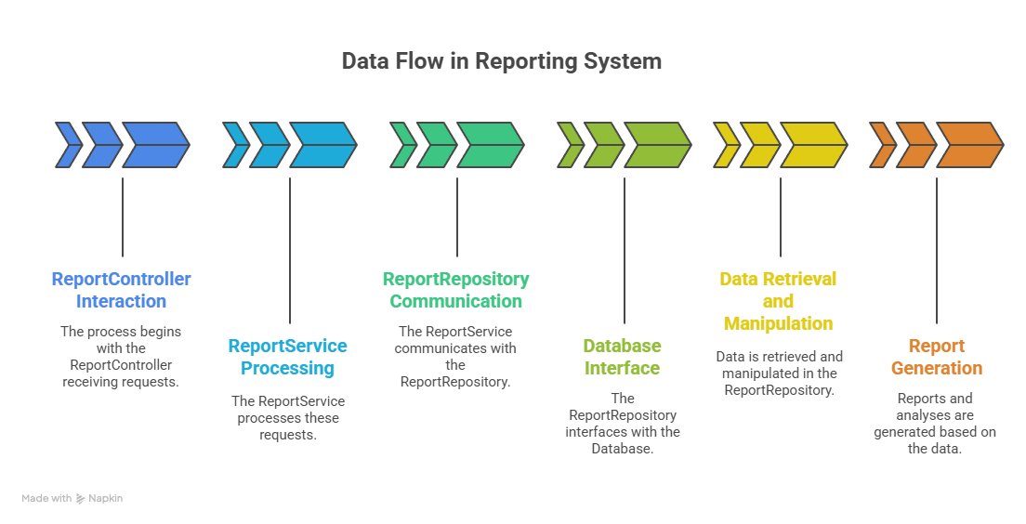
Flow

Slide 25
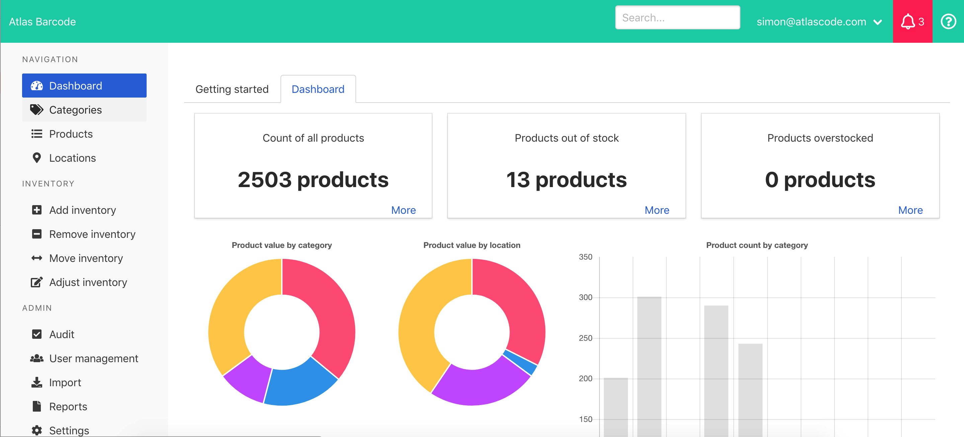
Module 4 – Inventory Management System
Module Introduction
The Inventory Management System is responsible for tracking, controlling, and maintaining stock levels in real time. It ensures that products are always available in the right quantity at the right time, reducing business losses.

Slide 26

Problem Statement
Traditional manual inventory systems face issues such as:
Stock mismatch and inaccuracies
Late identification of low-stock items
Over-stocking or under-stocking
Difficulty in maintaining records and reports
Solution: An automated Inventory Management Module.

Slide 27
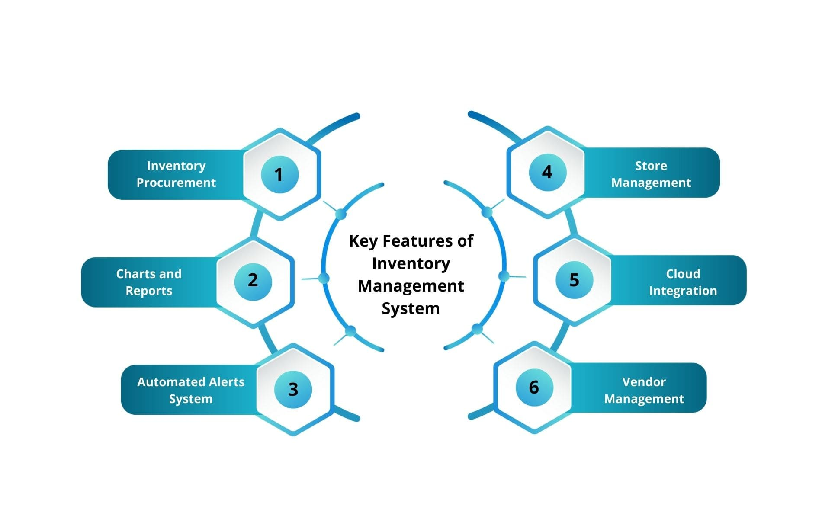
Objectives
Maintain accurate inventory records
Automatically update stock after purchase and sales
Identify low-stock items
Centralize inventory data for easy access

Slide 28
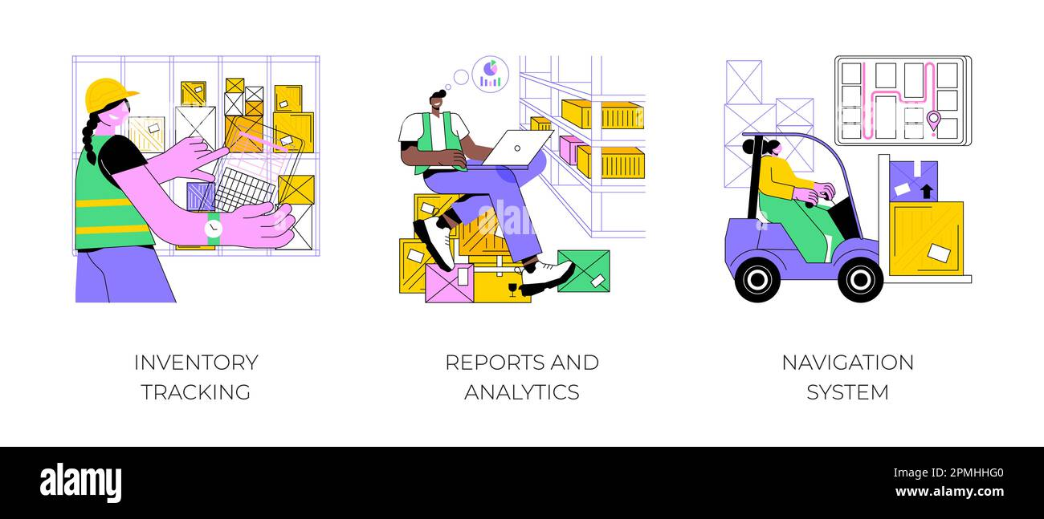
Key Features
Add, update, and delete products
Real-time stock quantity tracking
Minimum stock level configuration
Automatic stock updates on transactions
Secure data storage in database

Slide 29
Inventory Management Workflow
Admin adds products to inventory
Purchase transaction increases stock
Sales transaction decreases stock
System checks minimum stock threshold
Low-stock alert is generated if required

Slide 30
DATABASE TABLE
Column Name | Data Type | Description
product_id | INT (Primary Key) | Unique product identifier
product_name | VARCHAR(100) | Name of the product
category | VARCHAR(50) | Product category
quantity | INT | Available stock
min_stock_level | INT | Minimum stock threshold
price | DECIMAL(10,2) | Product price
last_updated | DATETIME | Last update timestamp

Slide 31
Pseudocode – Stock Update After Sale
BEGIN
INPUT product_id, sold_quantity
FETCH current_quantity FROM inventory WHERE product_id
updated_quantity = current_quantity - sold_quantity
UPDATE inventory SET quantity = updated_quantity
IF updated_quantity < min_stock_level THEN
DISPLAY "Low Stock Alert"
END IF
END

Slide 32
Pseudocode – Stock Update After Purchase
BEGIN
INPUT product_id, purchased_quantity
FETCH current_quantity FROM inventory WHERE product_id
updated_quantity = current_quantity + purchased_quantity
UPDATE inventory SET quantity = updated_quantity
END

Slide 33
Transaction Module Overview
The Transaction Module handles all purchase and sales activities in the system. It ensures that every transaction is accurately recorded and directly linked with the Inventory Management Module.
Types of Transactions:
Purchase Transaction (Stock In)
Sales Transaction (Stock Out)

Slide 34
Transaction Workflow
User initiates a purchase or sales transaction
Transaction details are validated
Transaction record is stored in the database
Inventory stock is automatically updated
System maintains a complete transaction history
This workflow ensures data consistency and real-time stock accuracy.

Slide 35
Transaction Database Table
Column Name | Data Type | Description
transaction_id | INT (Primary Key) | Unique transaction ID
product_id | INT (Foreign Key) | Linked inventory product
transaction_type | VARCHAR(20) | PURCHASE / SALE
quantity | INT | Transaction quantity
transaction_date | DATETIME | Date and time of transaction
total_amount | DECIMAL(10,2) | Total transaction value

Slide 36
Conclusion
Inventra simplifies inventory management and reporting.
Reduces human errors and improves decision-making.
Scalable solution for businesses of all sizes.
Future scope: Integration with AI for predictive stock management.

Slide 37
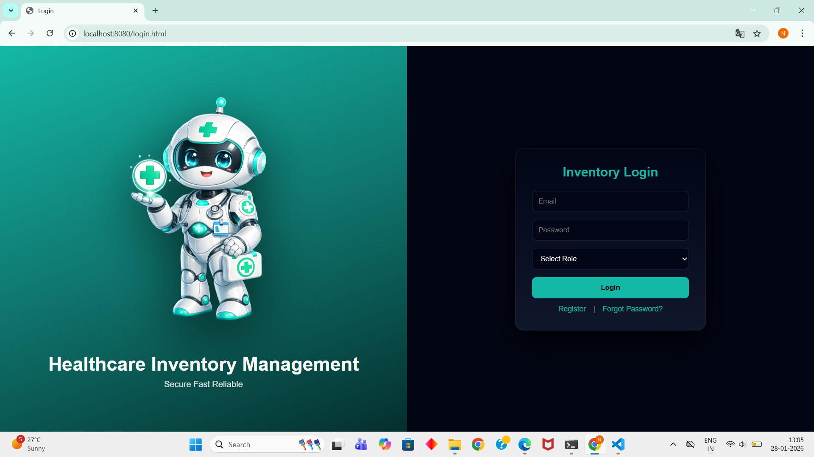
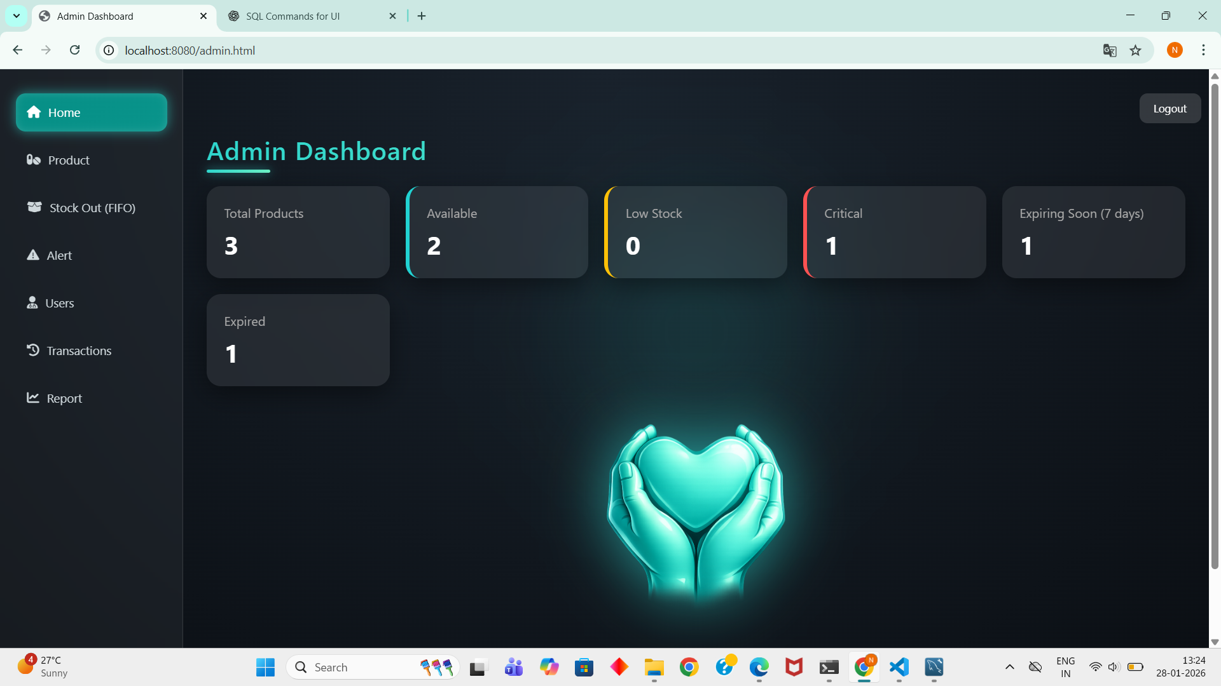
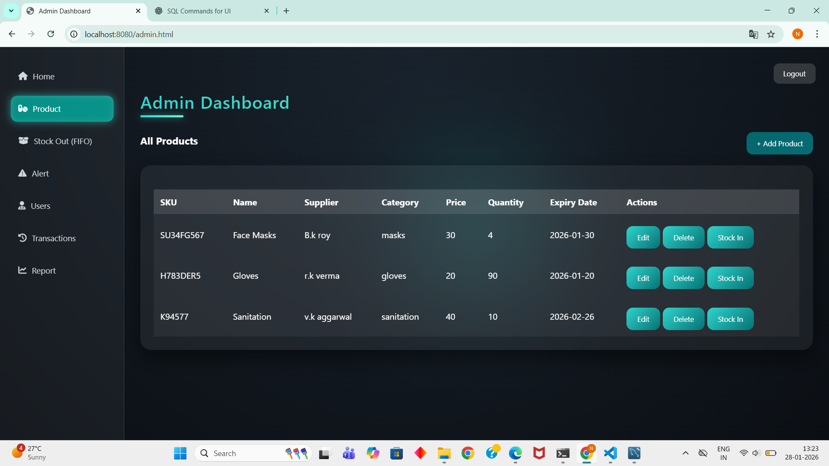
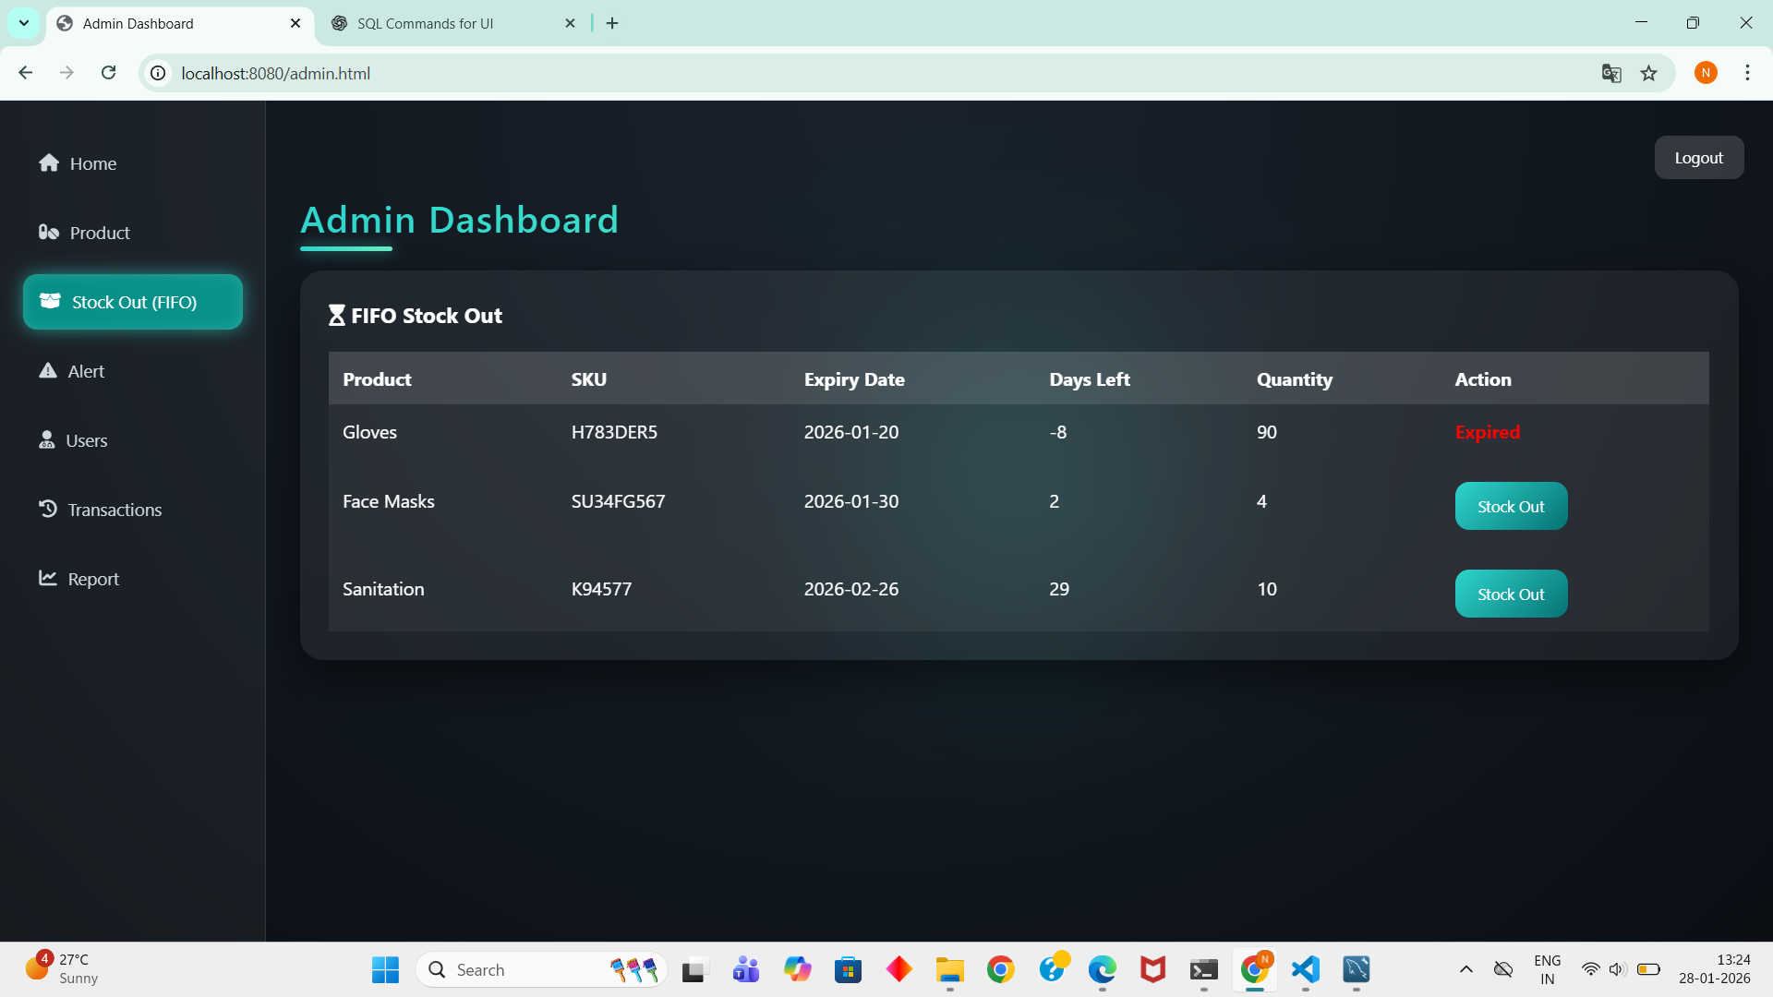
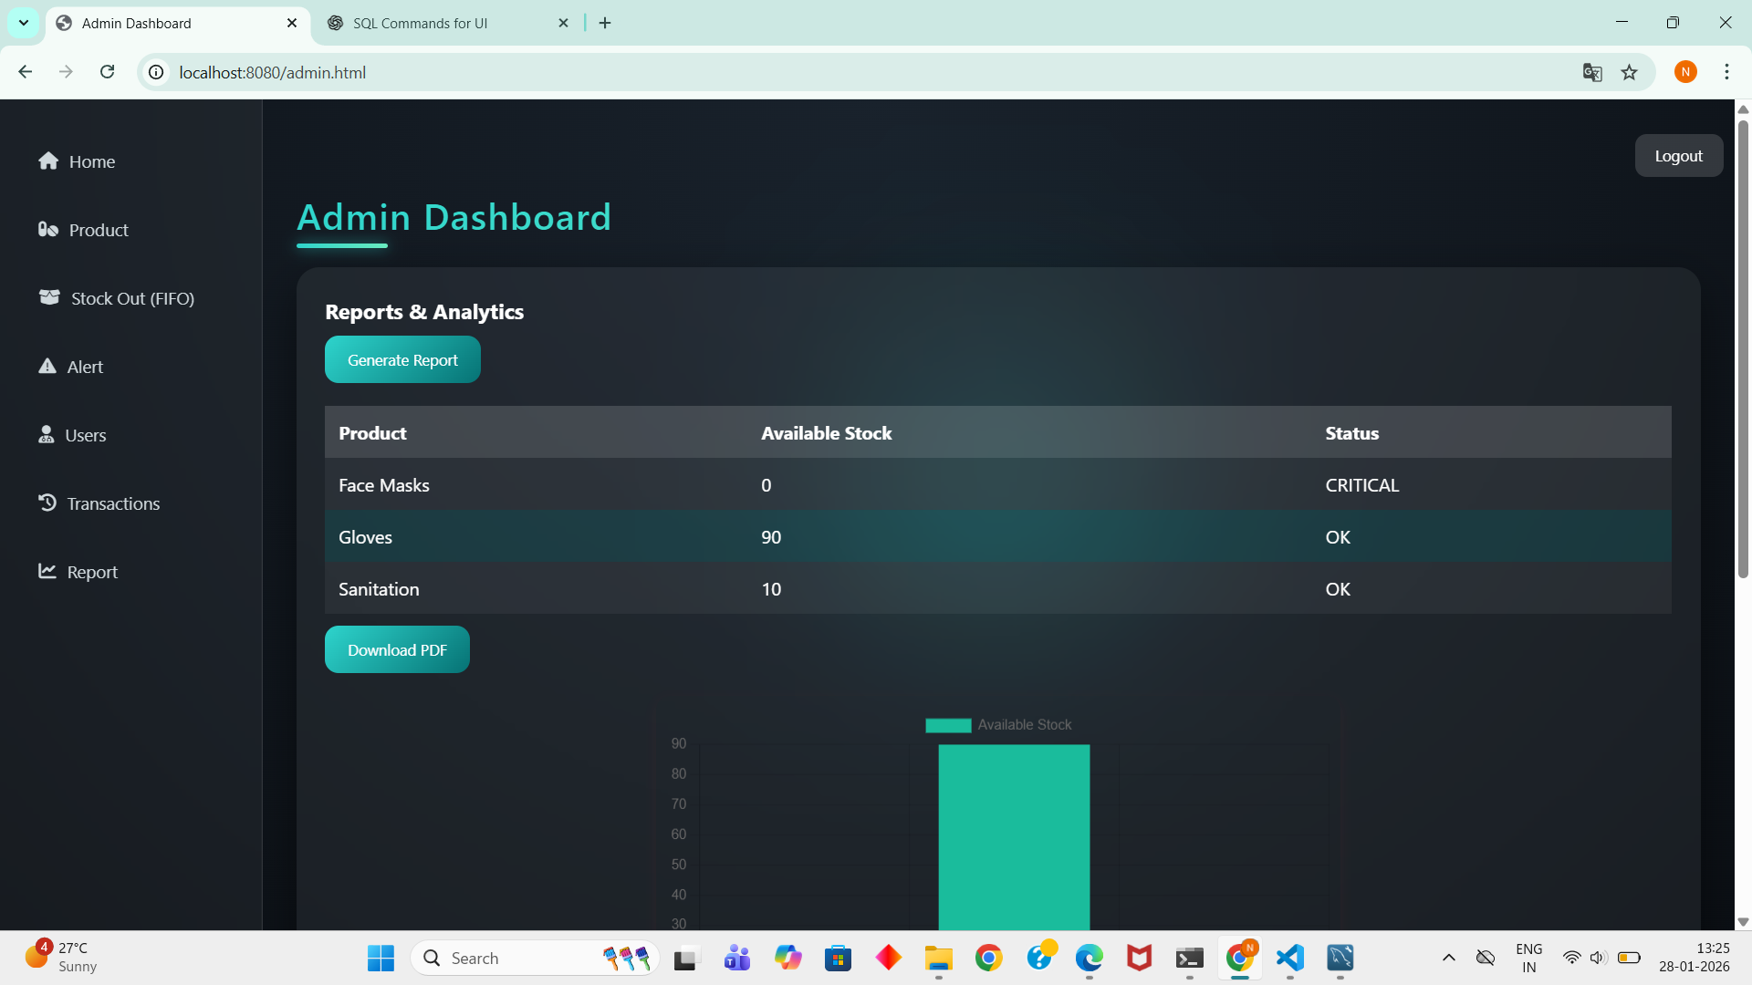
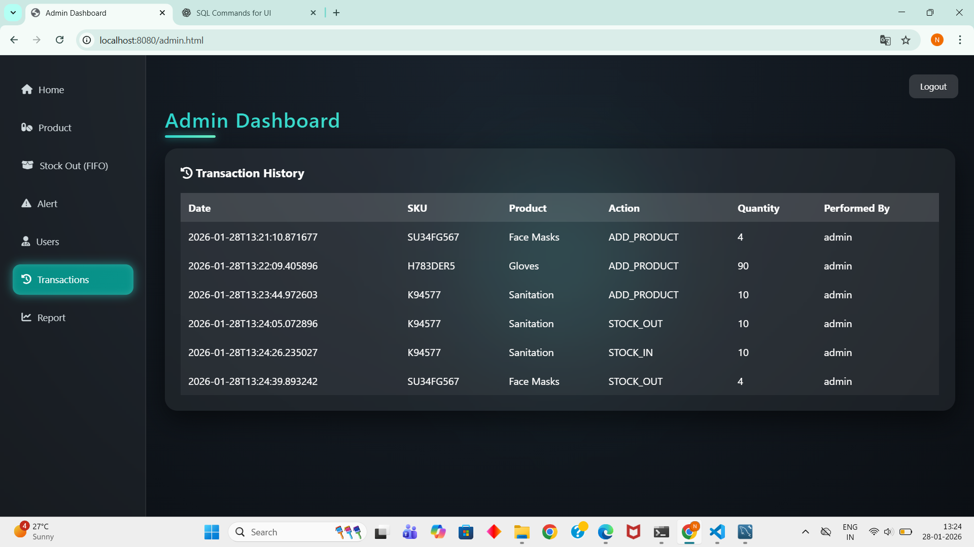
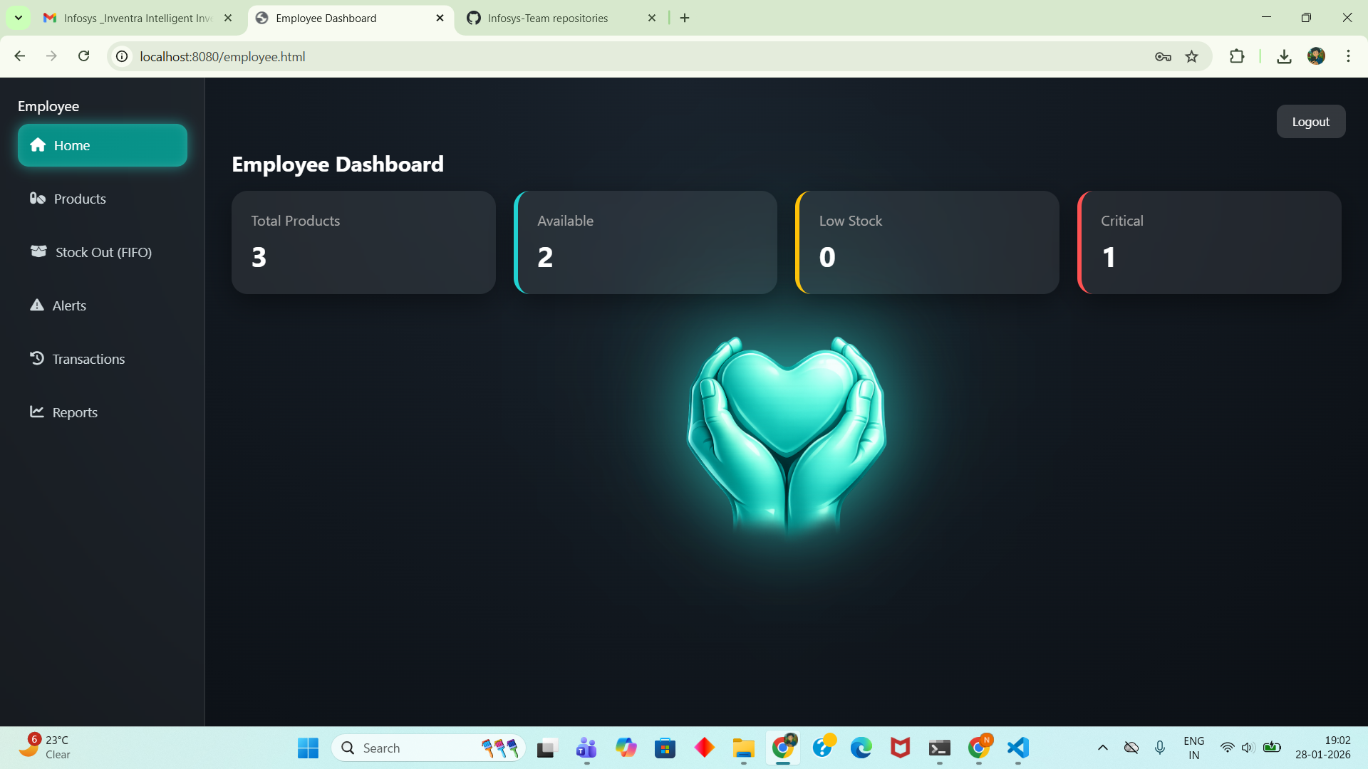
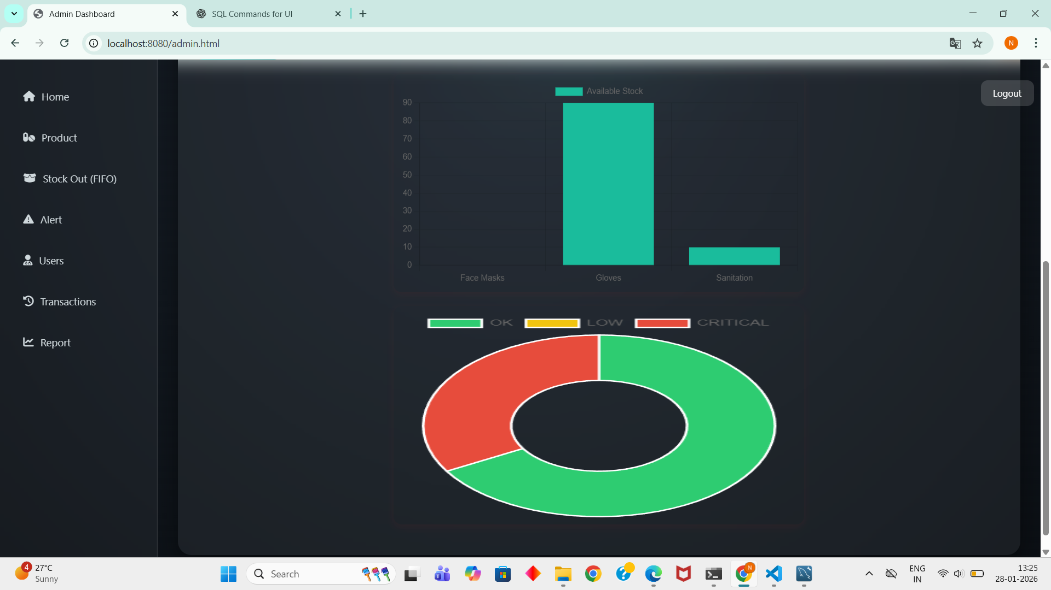
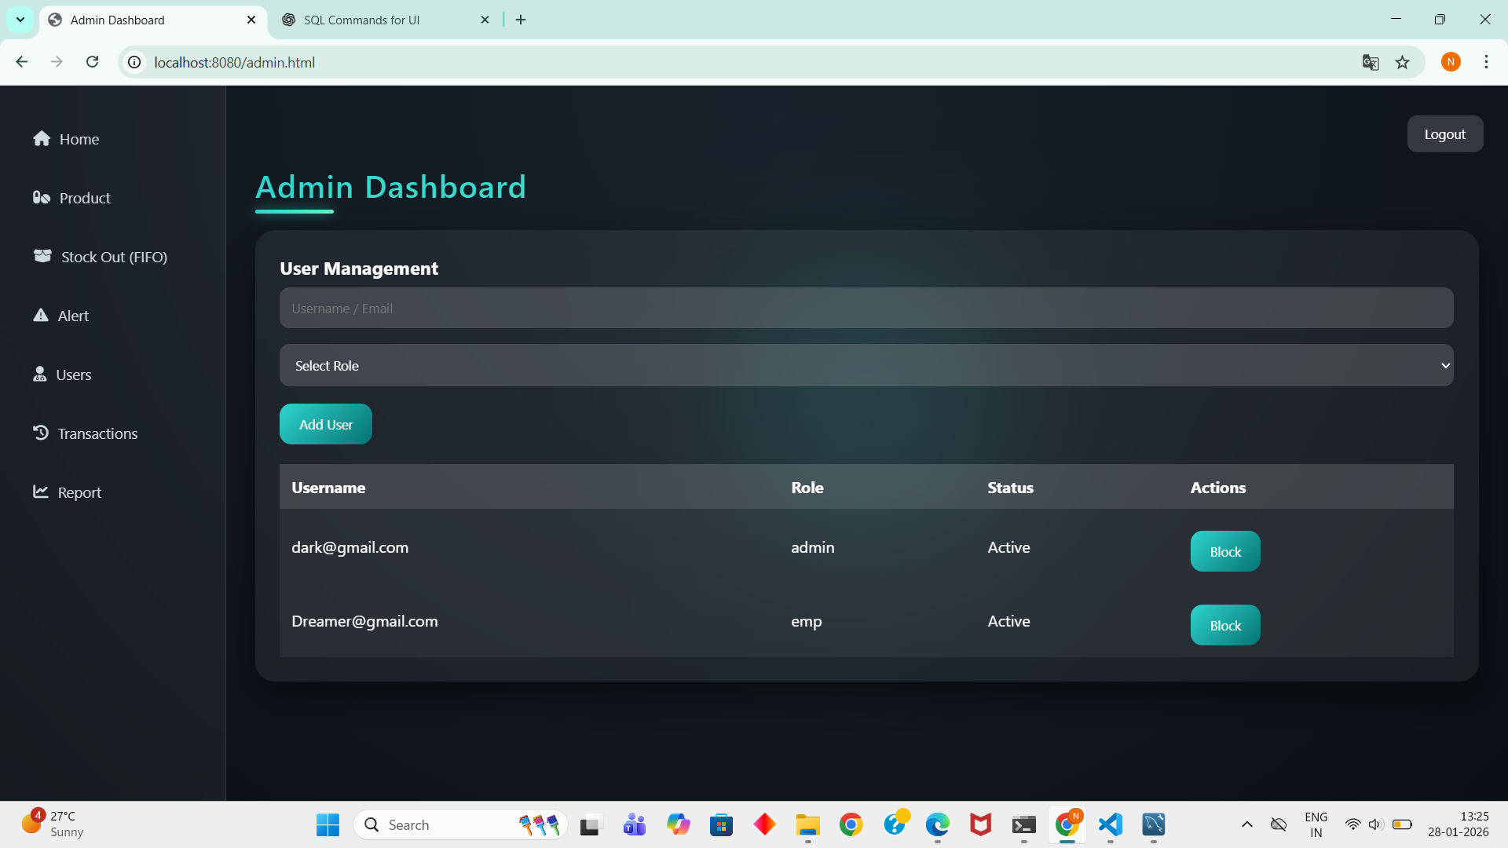

Slide 38
THANK YOU

